Slide 1

Personal Diary
_ Write your day _
Group no: 07 Group members : Anika Tasnim Maisha, Sadat Bin Nasar, Farhan Zaman.

Slide 2


What the project does:
Allows users to securely store diary entries
Supports adding, viewing, searching, editing, and deleting entries
Allows user to exporting all entries to a text file
Group no: 07 Group members : Anika Tasnim Maisha, Sadat Bin Nasar, Farhan Zaman.

Slide 3
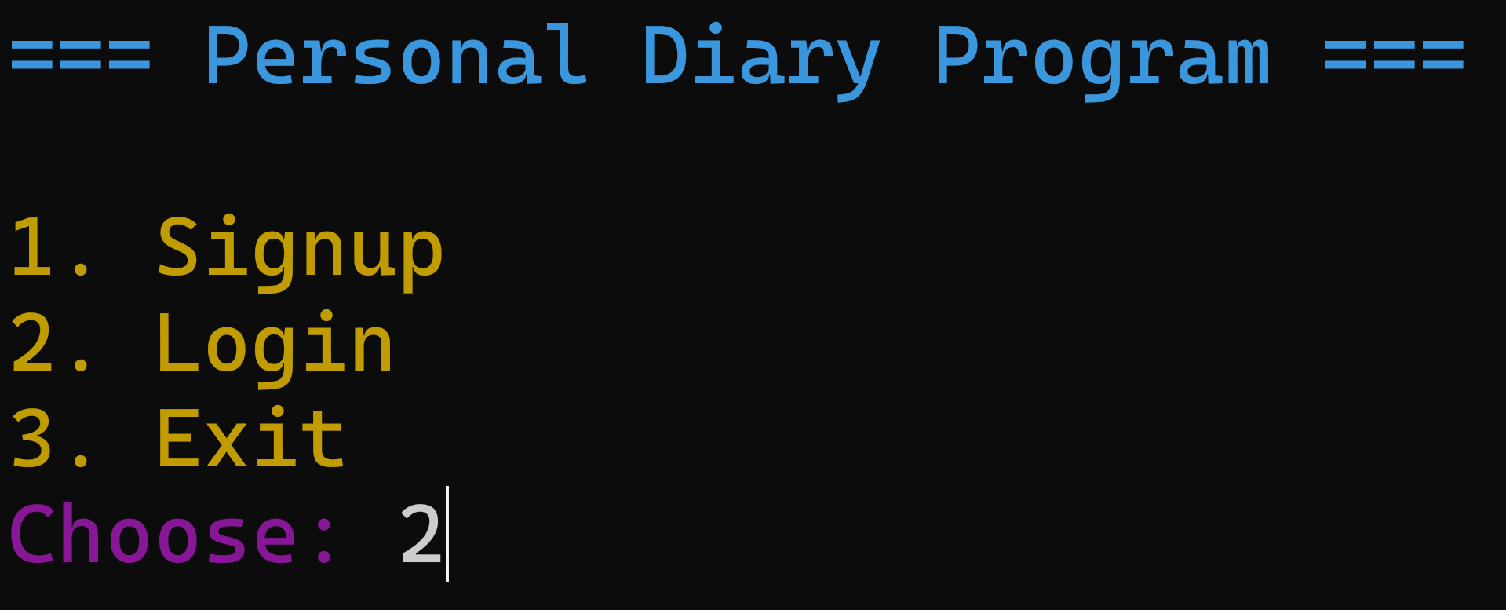

Your information, our responsibility.
Group no: 07 Group members : Anika Tasnim Maisha, Sadat Bin Nasar, Farhan Zaman.

Slide 4


Sign-up and Log-in with
your name and a password.
Group no: 07 Group members : Anika Tasnim Maisha, Sadat Bin Nasar, Farhan Zaman.

Slide 5
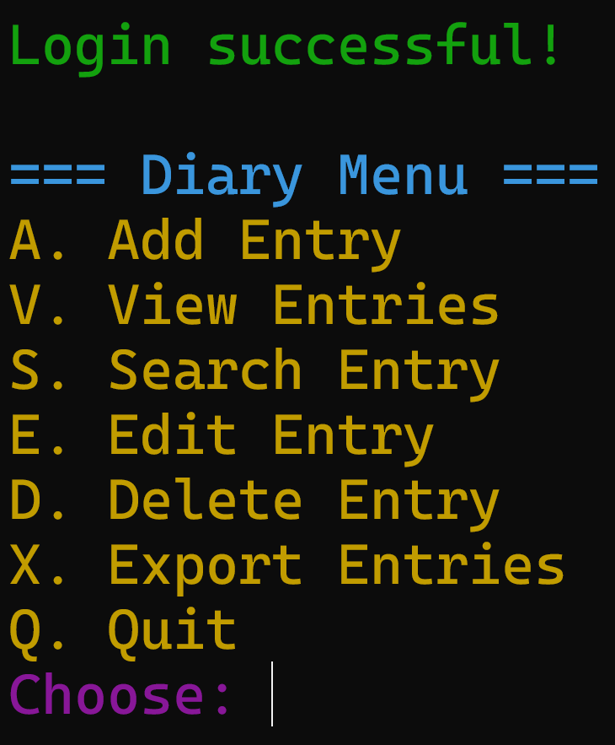

Key features that will provide users flexibility & enhance the usability.
Group no: 07 Group members : Anika Tasnim Maisha, Sadat Bin Nasar, Farhan Zaman.

Slide 6


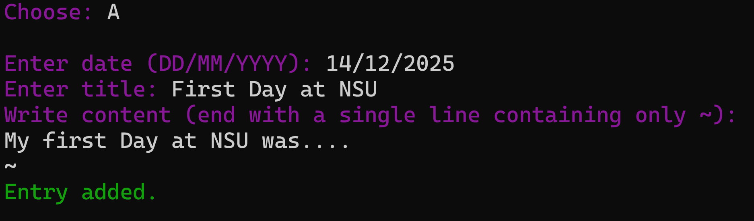
Journal your thoughts
Group no: 07 Group members : Anika Tasnim Maisha, Sadat Bin Nasar, Farhan Zaman.

Slide 7
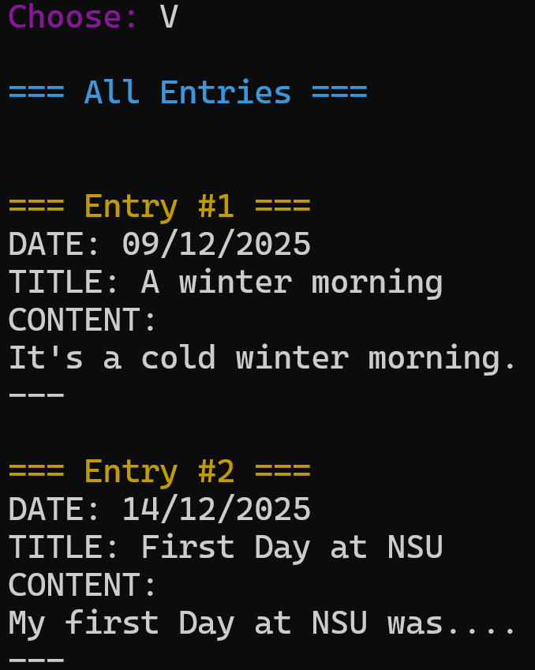


User can easily access and review all previous entries.
Group no: 07 Group members : Anika Tasnim Maisha, Sadat Bin Nasar, Farhan Zaman.

Slide 8

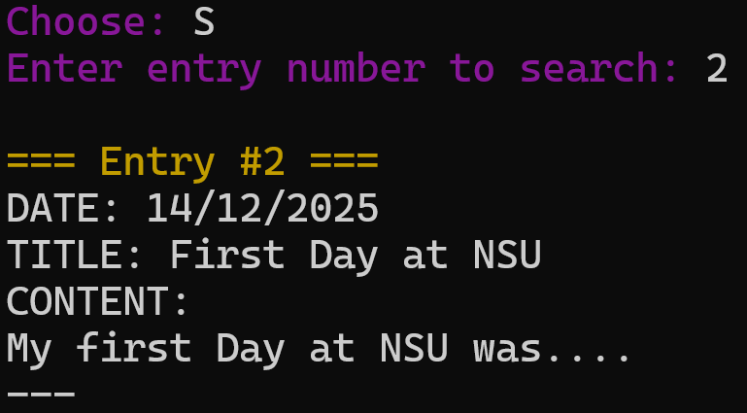

Search a particular diary entry easily.
Group no: 07 Group members : Anika Tasnim Maisha, Sadat Bin Nasar, Farhan Zaman.

Slide 9


Edit of Delete a particular entry.
Group no: 07 Group members : Anika Tasnim Maisha, Sadat Bin Nasar, Farhan Zaman.

Slide 10
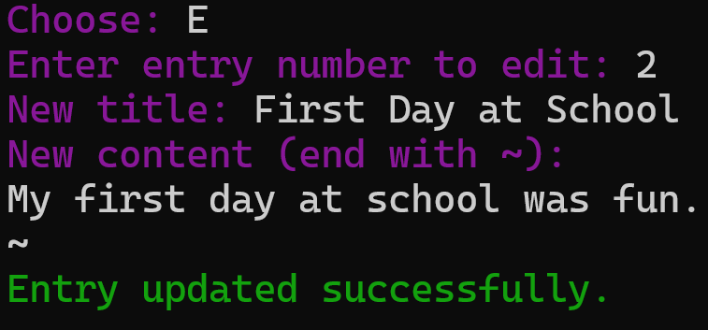
Edit an entry
Group no: 07 Group members : Anika Tasnim Maisha, Sadat Bin Nasar, Farhan Zaman.

Slide 11
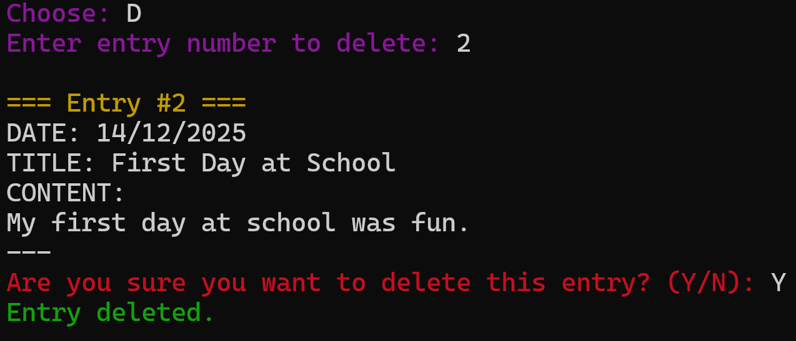
Delete a entry
Group no: 07 Group members : Anika Tasnim Maisha, Sadat Bin Nasar, Farhan Zaman.

Slide 12



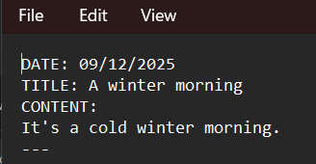
Export your diary entries to a Text file.
Group no: 07 Group members : Anika Tasnim Maisha, Sadat Bin Nasar, Farhan Zaman.

Slide 13
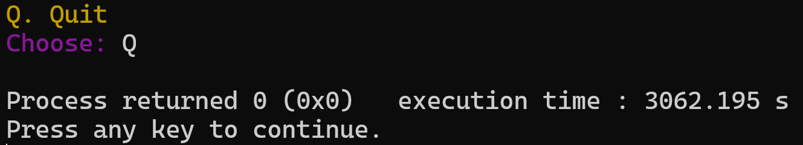

Quit when you are done.
Group no: 07 Group members : Anika Tasnim Maisha, Sadat Bin Nasar, Farhan Zaman.

Slide 14

Summary
Personal Diary System
Main Menu Add, View, Search, Edit, Delete and Export Entries.
Secure Login System
Group no: 07 Group members : Anika Tasnim Maisha, Sadat Bin Nasar, Farhan Zaman.

Slide 15
Thank You
Group no: 07 Group members : Anika Tasnim Maisha, Sadat Bin Nasar, Farhan Zaman.

